Slide 1

Interconnection Structures of
Multiprocessor System
(Computer Architecture & its Organization)
Computer Architecture & its organization
Dr. T Bernatin
Assistant Professor , School of EEE
Sathyabama Institute of Science and Technology
Chennai
bernatin.etc@sathyabama.ac.in

Slide 2
Outline
Computer Architecture & its organization
Unit V : Interconnection Structures
Input / output of a memory component
Time- Shared Common Bus
Multiport memory
Crossbar Switch
Multistage Switching Network

Slide 3
Interconnection Structures
Computer Architecture & its organization
A computer consists of a set of components (memory, I/O, CPU) that communicate with each other
The collection of paths connecting the various modules is called the interconnection structure
The design of this structure will depend on the exchange that must be made between module

Slide 4
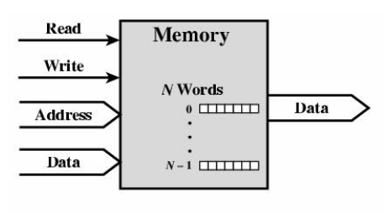
Input / output of a memory component
Interconnection Structures
Computer Architecture & its organization
Two operation
Read
    Input
Enable Read control signal
Provide the address on address bus where the data to read
Output
Data from the given address
Write
Input
Enable write control signal
Provide the address on the address bus where the data to be written
Provide the data to be written on data bus

Slide 5
Read operation of memory
Computer Architecture & its organization
Memory
0 | 11110000
1 | 10101010
2 | 10001000
3 | 10010010
4 | 01010101
5 | 00100101
6 | 10100010
7 | 10010101
Read
00100101
Address
5
5

Slide 6
Write operation of memory
Computer Architecture & its organization
Memory
0 | 11110000
1 | 10101010
2 | 10001000
3 | 10010010
4 | 01010101
5 | 00100101
6 | 10100010
7 | 10010101
Write
Address
5
4
00000000
Data
00000000

Slide 7
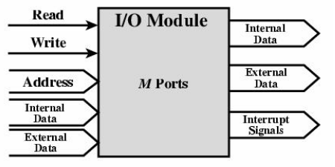
Input and output of I/O Module
Computer Architecture & its organization
    I/O Module may control more than one external devices
Each of the interface to an external devices is referred as port and given each a unique Address (e.g 0,1, …… M-1 )
Finally, an I/ O module may be able to send interrupt signal to the processor
Internal = > Computer system (similar to memory )
External => External device

Slide 8
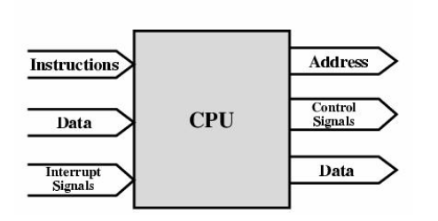
Input and Output of Processor Component
Computer Architecture & its organization
The processor read the instructions and data, writes out data after processing, and uses control signals to control the overall operation of the system

Slide 9
Scheme
Computer Architecture & its organization
Interconnection structures
Time- Shared Common Bus
Multiport Memory
Crossbar Switch
Multistage Switching Network

Slide 10
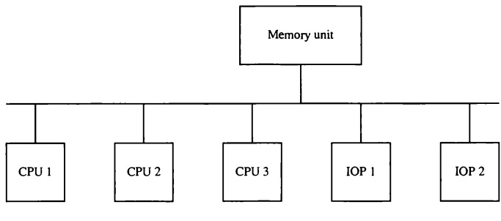
Time shared common Bus
Computer Architecture & its organization
Transfer operations are conducted by the processor that is in control of the bus at the time
Any other processor wishing to initiate a transfer must first determine the availability status of the bus. When the bus is available, processor address the destination unit to initiate the transfer.
A command is issued to inform the destination unit what operation is to be performed
The receiving unit recognizes its address in the bus and responds to the control signals from the sender, after which the transfer is initiated
The system may exhibit transfer conflicts since one common bus is shared by all processors
A Common Bus Multiprocessor System consists of a number of processor connected through a common path to a memory unit
Only one processor can communicated with the memory or another processor at any given time

Slide 11
Time shared common Bus
Computer Architecture & its organization
These conflicts must be resolved by incorporating a bus controller that establishes priorities among the requesting units.
A single common-bus system is restricted to one transfer at a time
This means that when one processor is communicating with the memory, all other processors are either busy with internal operations or must be idle waiting for the bus
As a consequence, the total overall transfer rate within the system is limited by the speed of the single path.
Performance of the System can increase , if two or more independent buses to permit simultaneous bus transfer
However, this increases the system cost and complexity.

Slide 12
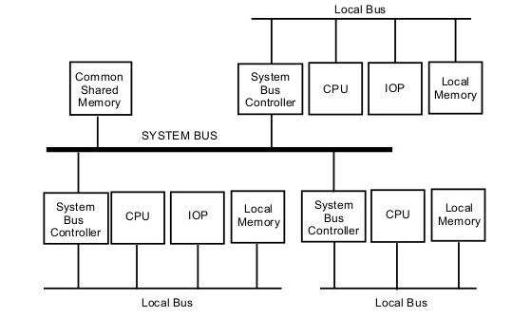
Time shared common Bus
Computer Architecture & its organization
Here we have a number of local buses each connected to its own local memory and to one or more processors
Each local bus may be connected to a CPU, an lOP, or any combination of processors
A system bus controller links each local bus to a common system bus
The I /O devices connected to the local lOP, as well as the local memory, are available to the local processor.
The Common shared memory connected to the common bus is shared by all processor
If an IOP can connected directly to the system bus, the I/O devices attached to it may be made available at all processor

Slide 13
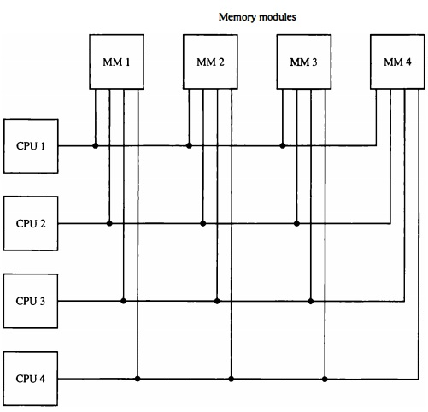
Multiport memory
Computer Architecture & its organization
A multiport memory system employs separate buses between each memory module and each CPU
A processor bus consists of the address, data, and control lines required to communicate with memory
The memory module is said to have four ports and each port accommodates one of the buses
The module must have internal control logic to determine which port will have access to memory at any given time
Memory access conflicts are resolved by assigning fixed priorities to each memory port

Slide 14
Multiport memory
Computer Architecture & its organization
The priority for memory access based on the physical port position
Thus CPU 1 will have priority over CPU 2, CPU 2 will have priority over CPU 3, and CPU 4 will have the lowest priority
This interconnection structure is usually appropriate for the system with a small number of processor
Advantages
Higher transfer rate achieved due to multiple paths between processor and memory
Disadvantages
Requires Expensive memory control logic
Requires large number of cables and connectors

Slide 15
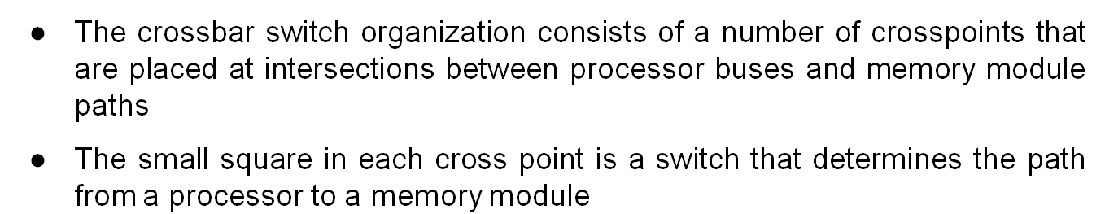
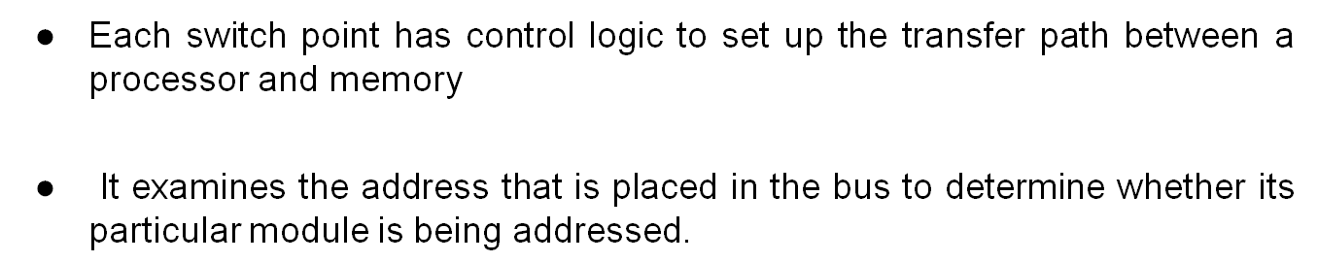
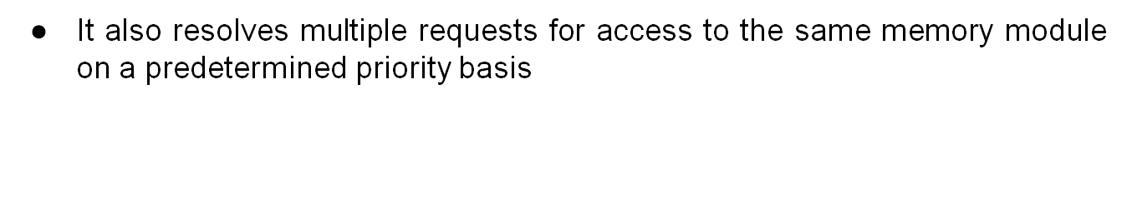
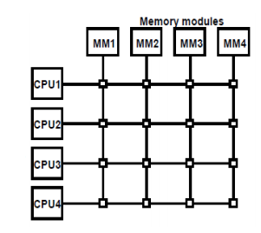
Cross bar Switch
Computer Architecture & its organization

Slide 16

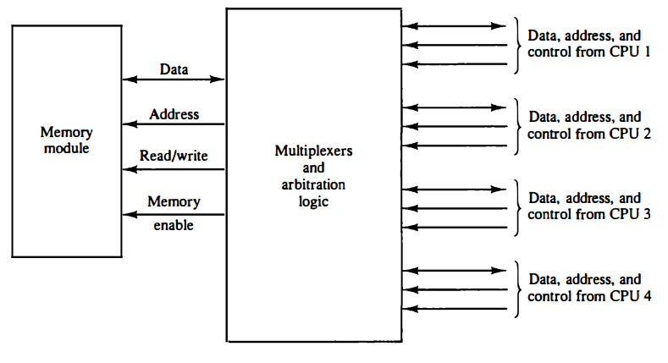
Cross bar Switch
Computer Architecture & its organization
      The circuit consists of multiplexers that select the data, address, and control from one CPU for communication with the memory module
Priority levels are established by the arbitration logic to select one CPU, when two or more CPUs attempt to access the same memory

Slide 17
Cross bar Switch
Computer Architecture & its organization
Advantages
Support Simultaneous transfer from memory modules
It provides full connectivity
Highly useful in multiprocessor System
Maximum use of Bandwidth compare to other Networks
Disadvantage
Number of cross point = N²
Complex Hardware requirement

Slide 18
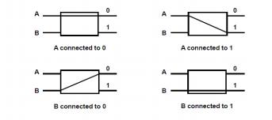
Multistage Switching Network
Interconnection Structures
Operation of 2x2 interchange switch
The basic component of a multistage network is a two-input, two-output interchange switch
The switch has the capability of connecting input A to either of the outputs. Terminal B of the switch behaves in a similar fashion
If input A and B both request the same output terminal , only one of them will be connected ; the other will be blocked

Slide 19
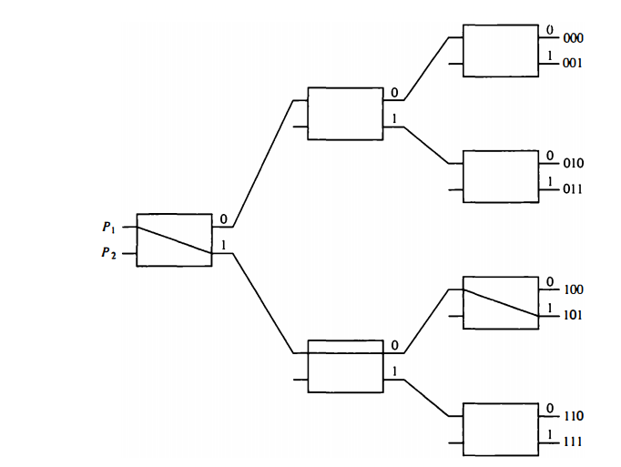
Binary Tree Switches
Interconnection Structures
    The first bit of the destination number determines the switch output in the first level
      The second bit specifies the output of the switch in the second level, and the third bit specifies the output of the switch in the third level.
    It is clear that either P1 or P2 can be connected to any one of the eight memories.
    Certain request patterns, however, cannot be satisfied simultaneously
    For example, if P1, is connected to one of the destinations 000 through 011, P2 can be connected to only one of the destinations 100 through 111
Using the 2 x 2 switch as a building block, it is possible to build multistage network to control the communication between a number of source and destinations
The two processors P1 and P2 are connected through switches to ei! memory modules marked in binary from 000 through 111
    To Path from a source to a destination is determined from the binary bits of the destination number
    To connect P1 to memory 101, it is necessary to form a path from P1 to output 1 in the first-level switch, output 0 in the second-level switch, and output 1 in the third-level switch

Slide 20
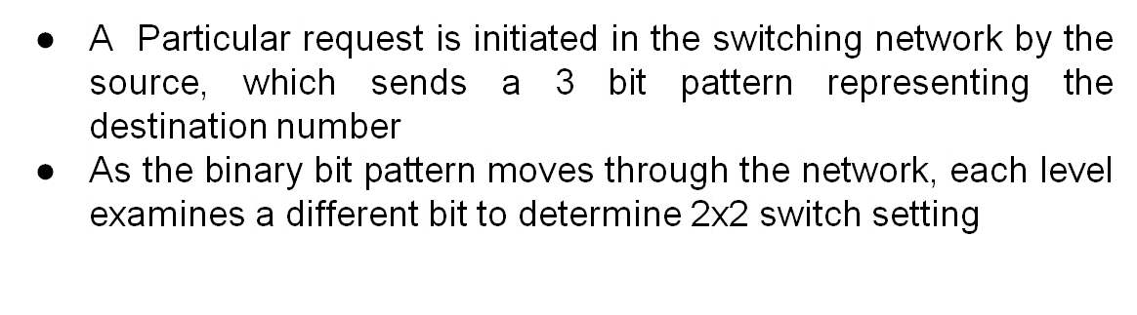
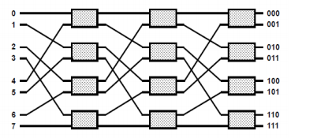
8x8 Omega switching Network
Level 1 inspects the most significant bit. level 2 inspects the middle bit, and level 3 inspects the least significant bit.
When the request arrives on either Input of the 2 x 2 switch, it is routed to the upper output if the specified bit is 0 or to the lower output if the bit is 1

Slide 21
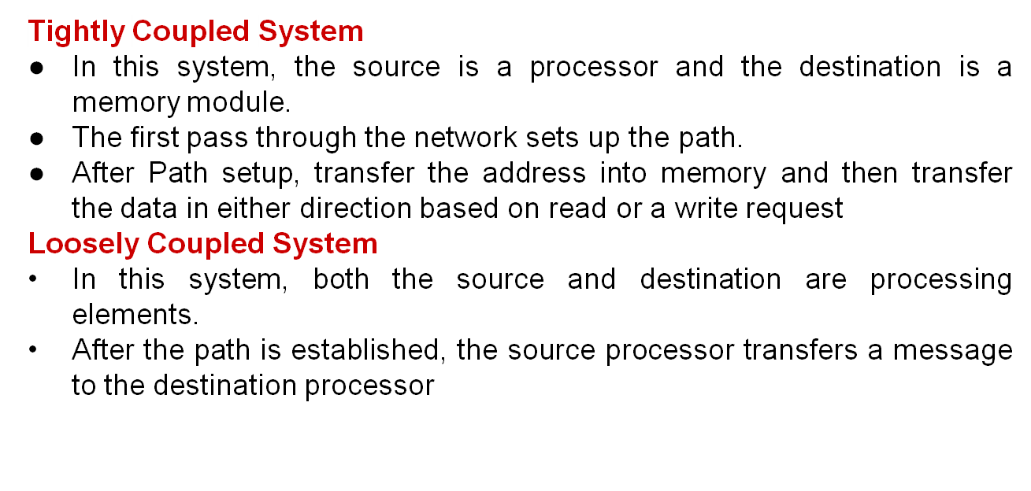
8x8 Omega switching Network

Slide 22
Omega Switching Network
Omega Network has self routing property. It works for each possible input
The interconnection between stages are defined by the logical “rotate left” of the bits used in the ports.
Example : 000 ->000->000->000
Example : 001 ->010->100->001
Example : 011 ->110->101->011
Example : 111 ->111->111->111
- If bit is “0” then send cell out upper port
If bit is “1” then send cell out lower port

Slide 23
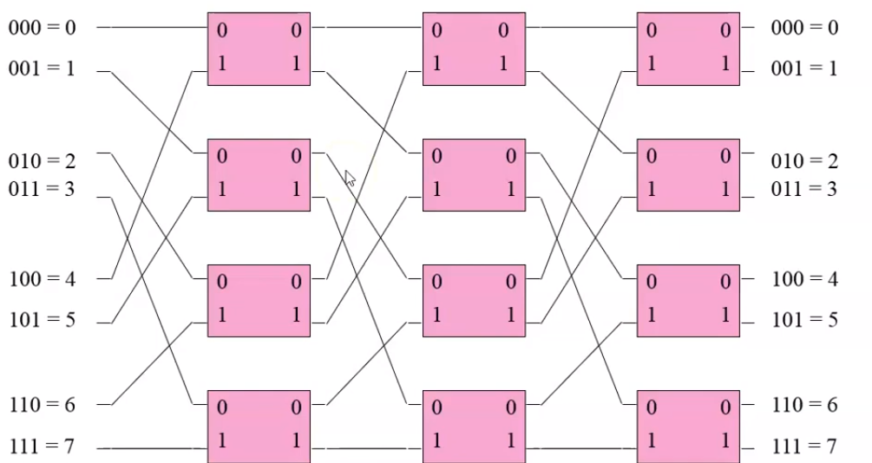
Omega Switching Network
Example : 001 ->010->100->001

Slide 24
THANK YOU

